Slide 1

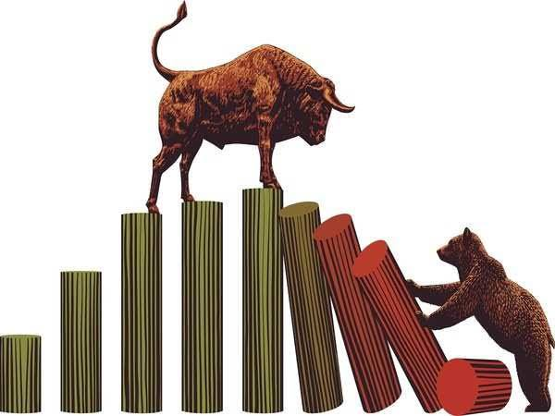
Capstone Project - II
Regression – Yes Bank Stock Closing Price Prediction
By – Reetika Srivastava

Slide 2
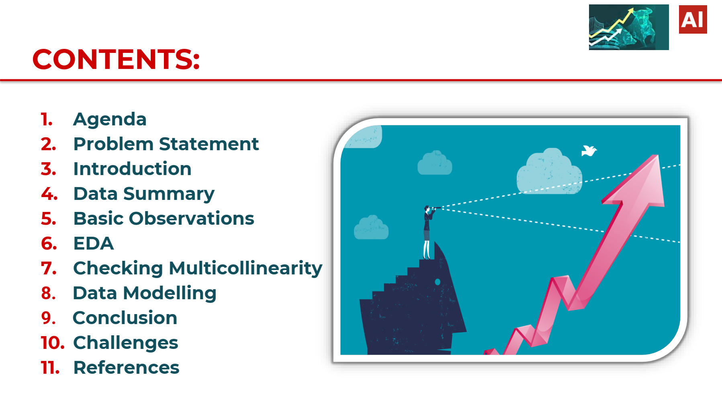

Points For Discussion

Slide 3
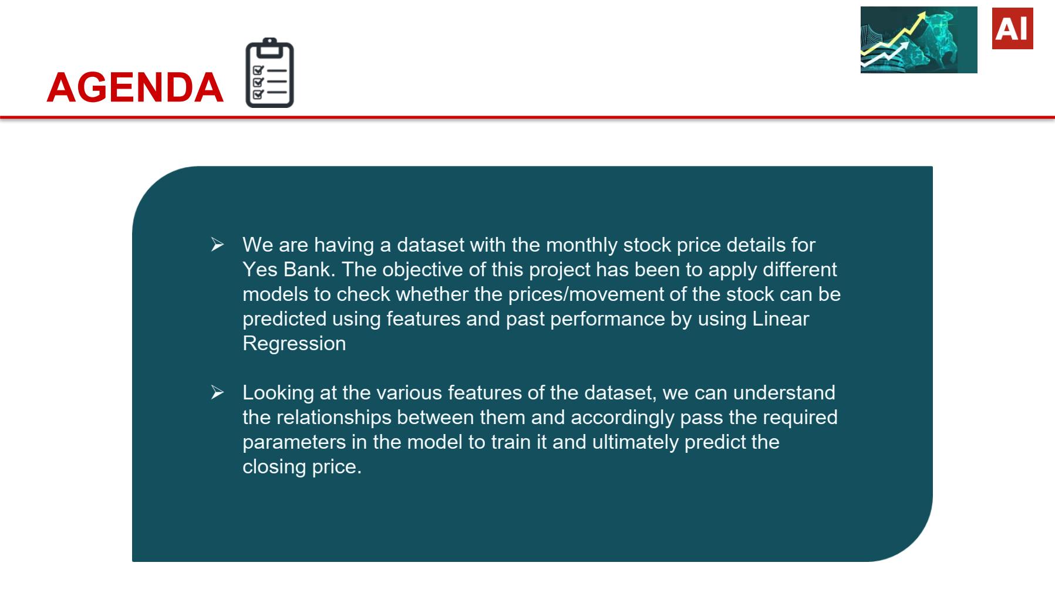

Slide 4
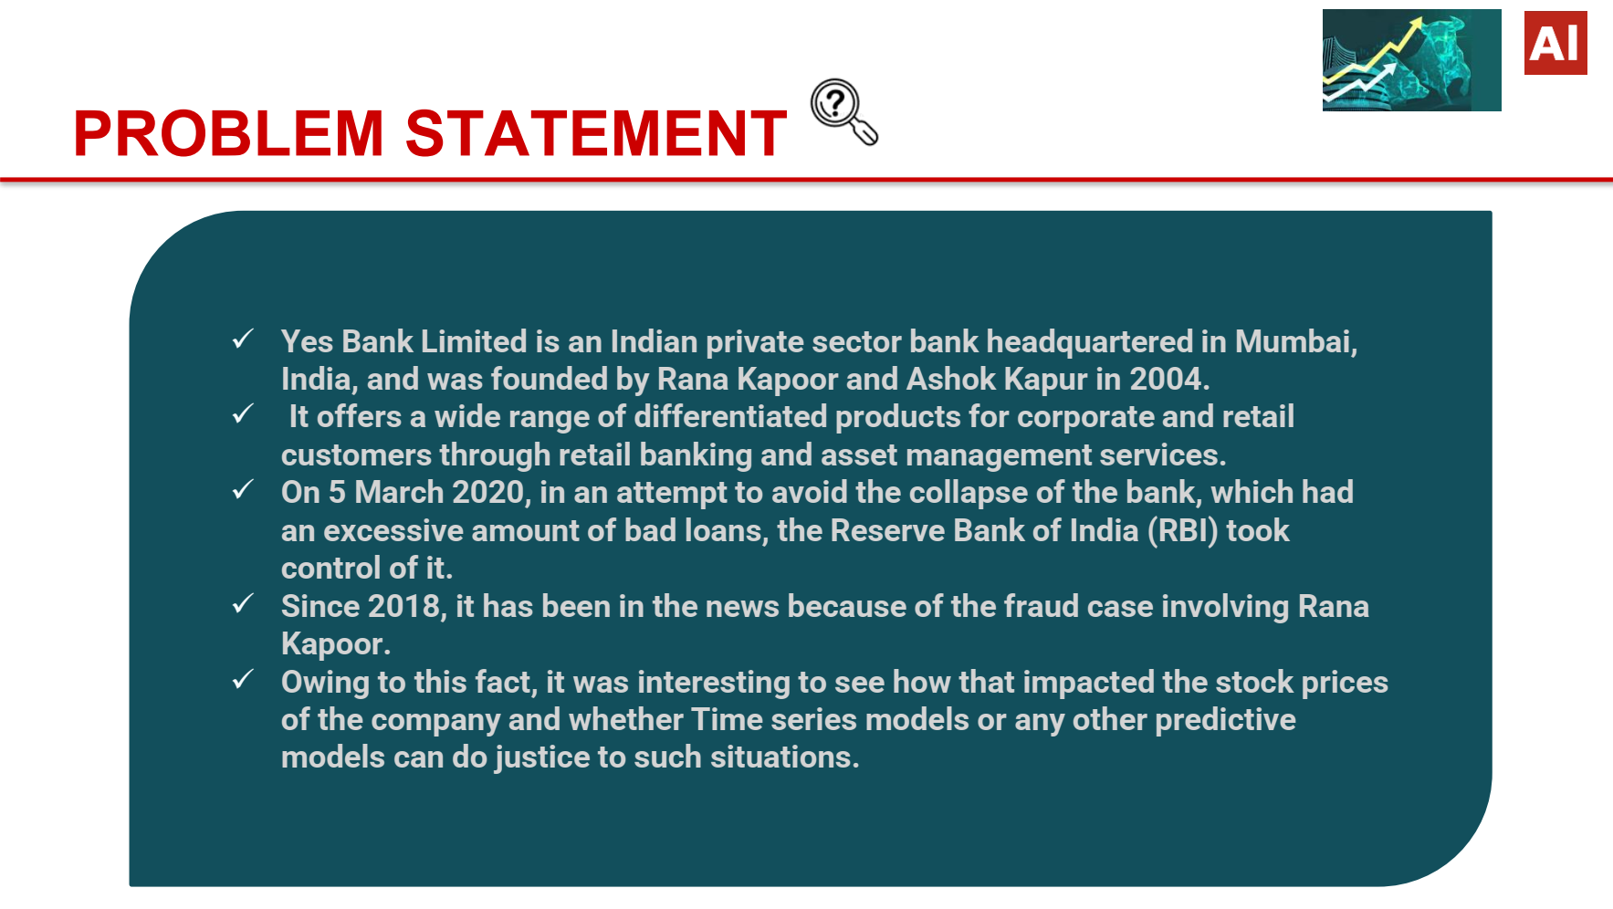

Slide 5
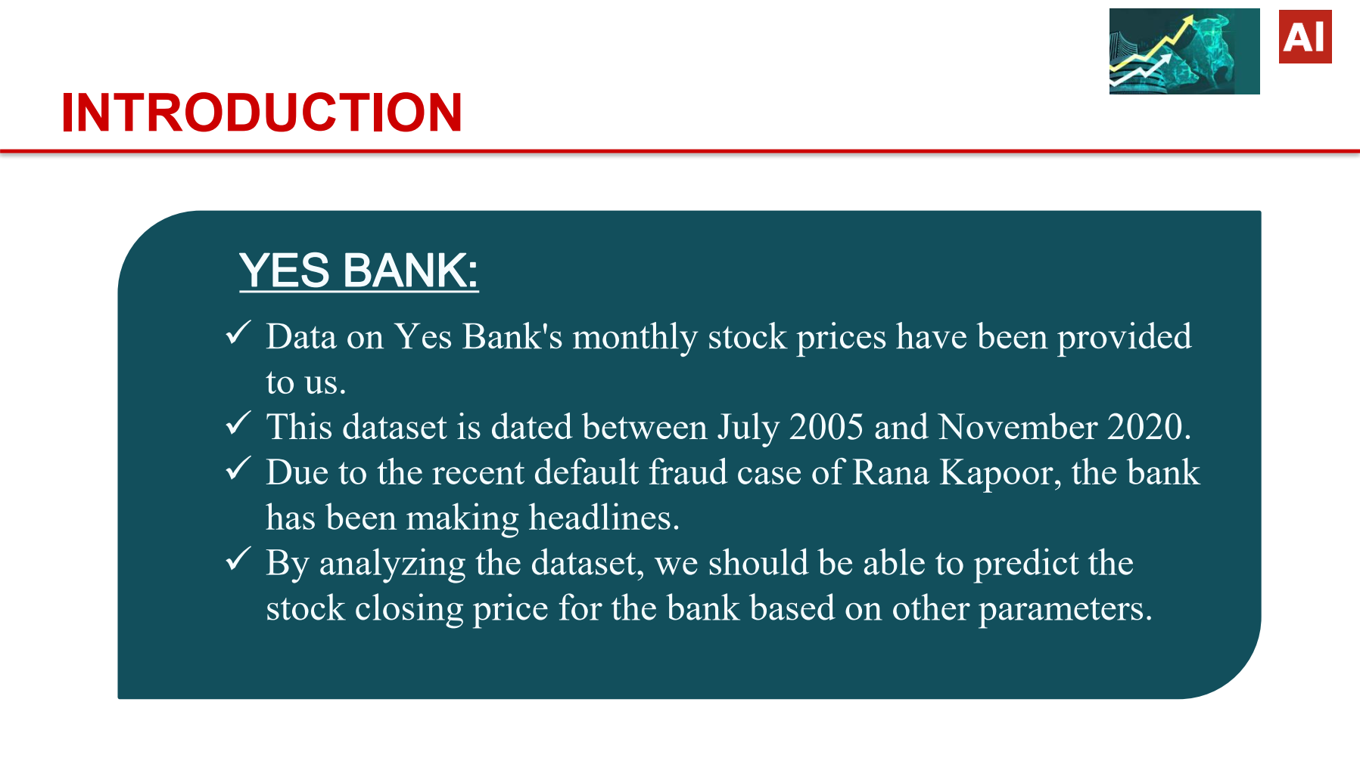

Slide 6

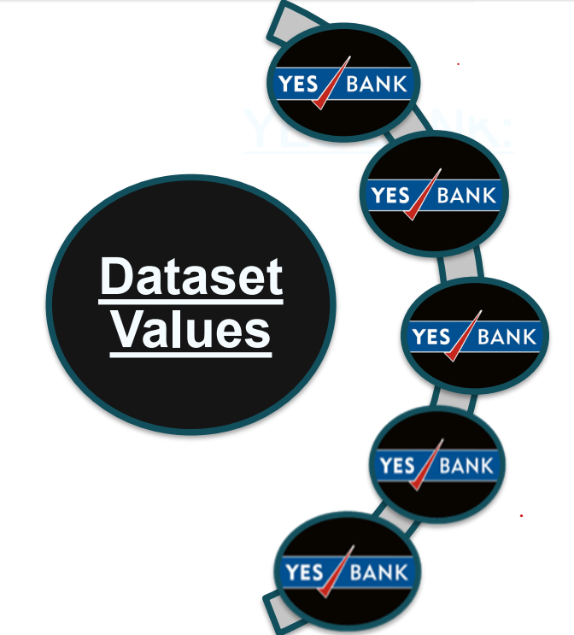
Date:- It denotes the month and year or a specific pricing.
Open:- The price at which a stock started trading that month is referred to as the "Open"
Low:- It describes the monthly minimum price.…
High:- The highest price for that particular month.
Close:- It refers to the Final trading price for that month , which we have to predict using regression.

Slide 7
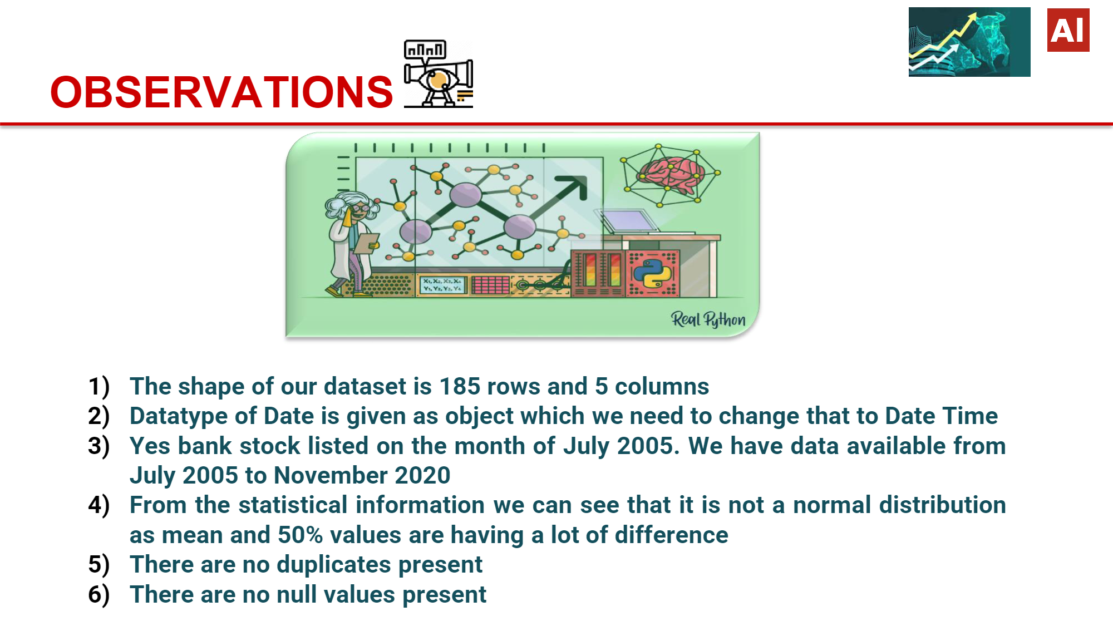
Capstone Project - II
Regression – Yes Bank Stock Closing Price Prediction

Slide 8
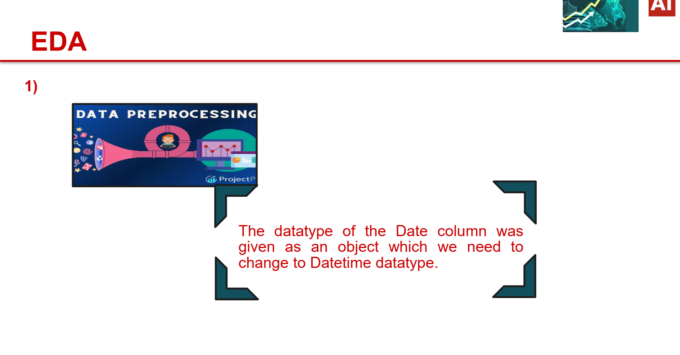

Slide 9


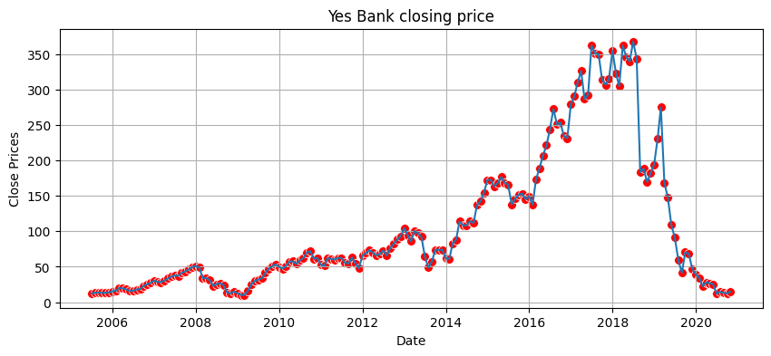
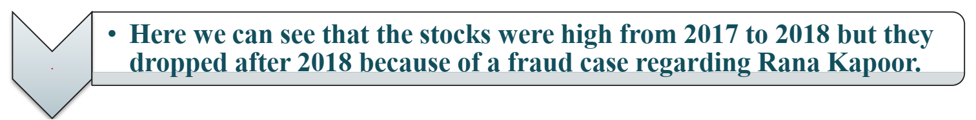

Insight’s found
from the
chart?
From the above chart we can see that there was a good price rise from July 2005 till 2018 and it was a good time to invest as there was a up trend. The price between 5Rs - 10Rs in around July 2005 and reached a peak price of above 350 Rs in the year 2018.

Slide 10
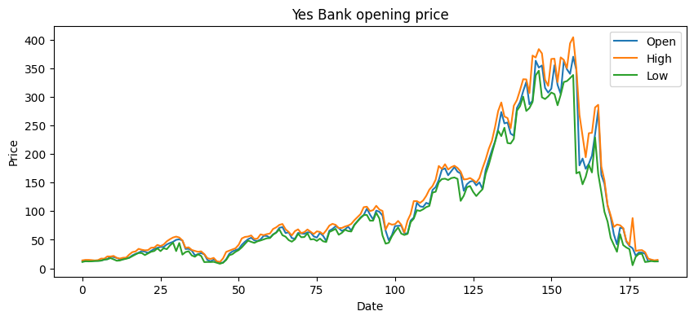
This chart gives us a clear understanding and visualization of our independent variables open , high and price from July 2005 till November 2020
The insights can help in creating a positive business impact, as we can see the up trend in the stock price from July 2005 to 2018 which was a beneficial time for the investor and after Rana Kapoor fraud there was downtrend in the stock price..

Slide 11

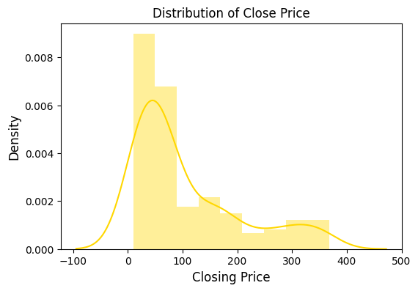
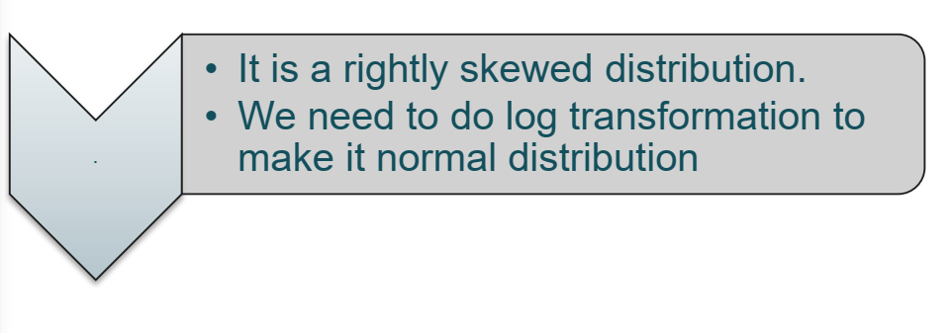

Slide 12
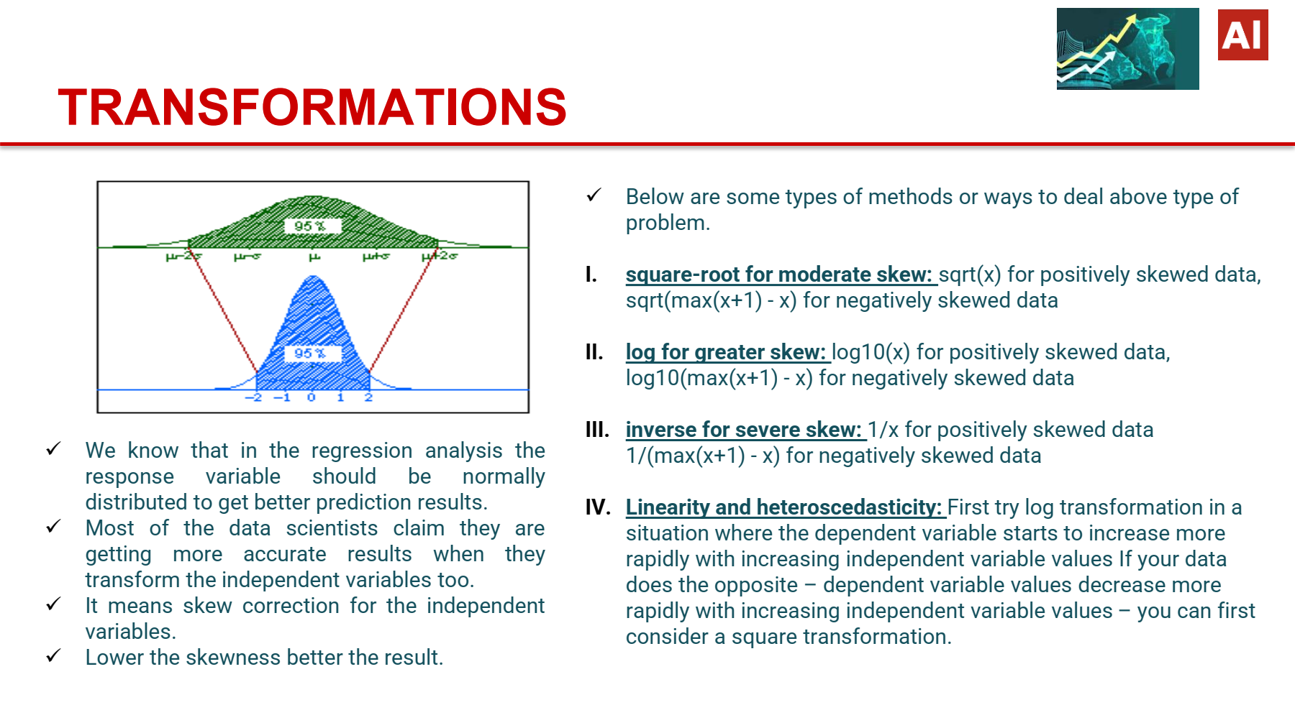

Slide 13
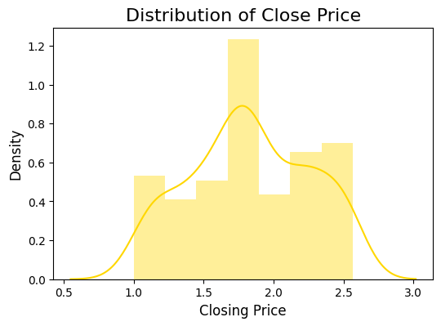
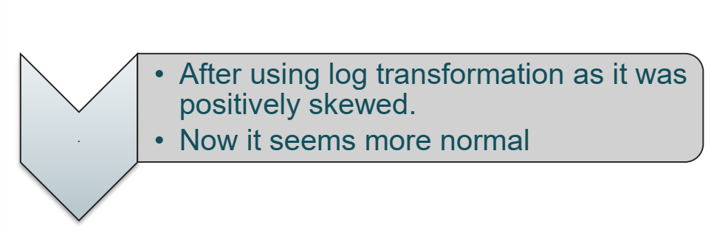

Slide 14
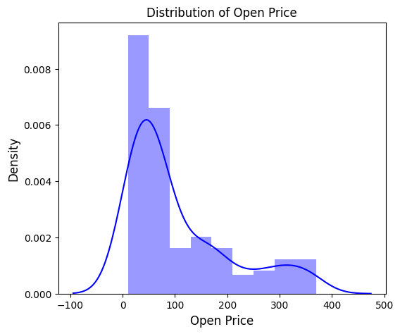
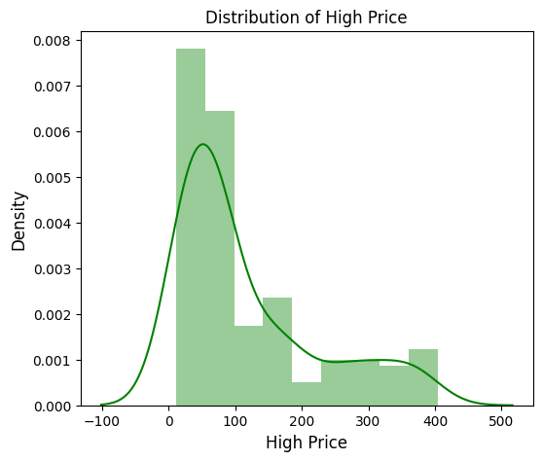
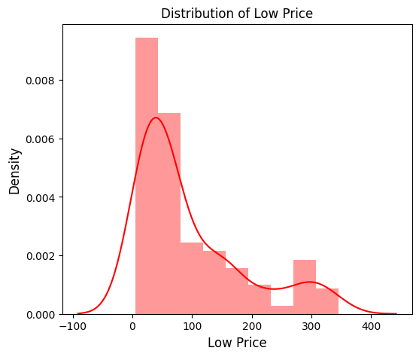
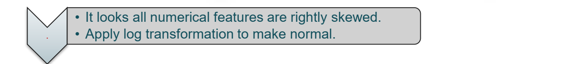
Distribution of High Low and Normal Price of a Stock

Slide 15
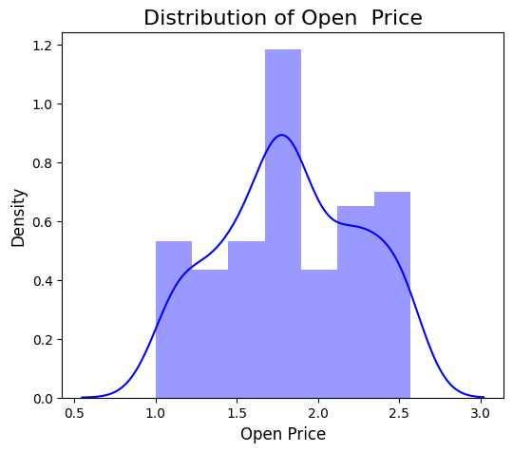
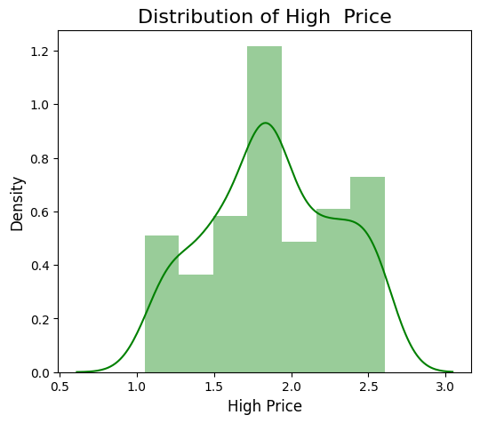
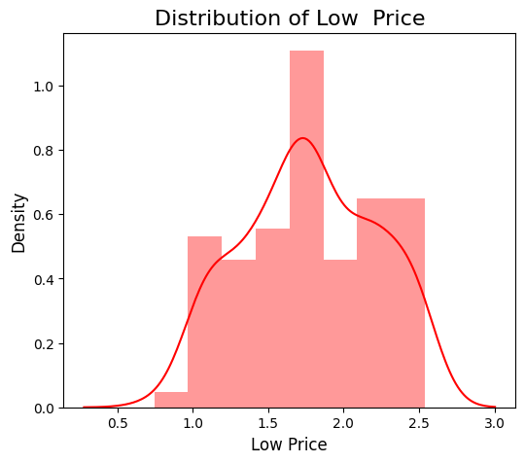
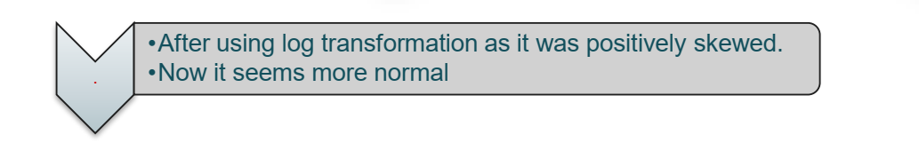
Distribution of High Low and Normal Price of a Stock {After Transformations }

Slide 16
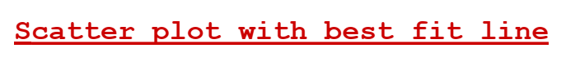
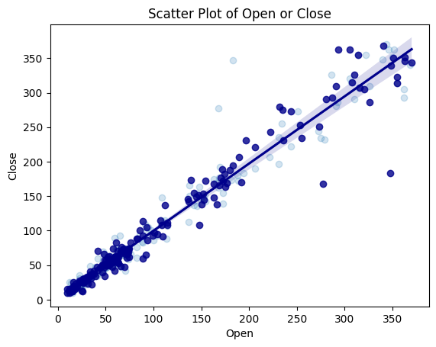
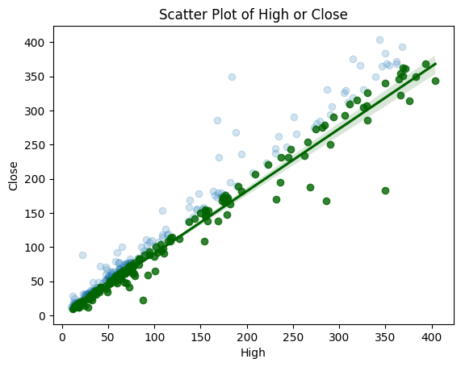
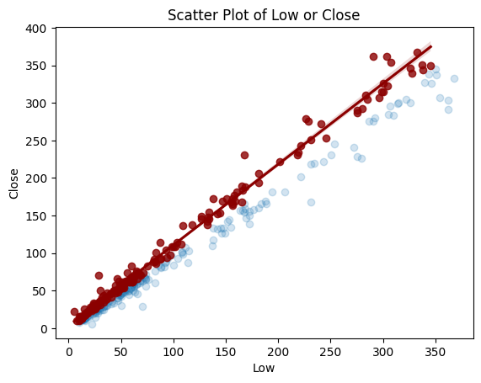
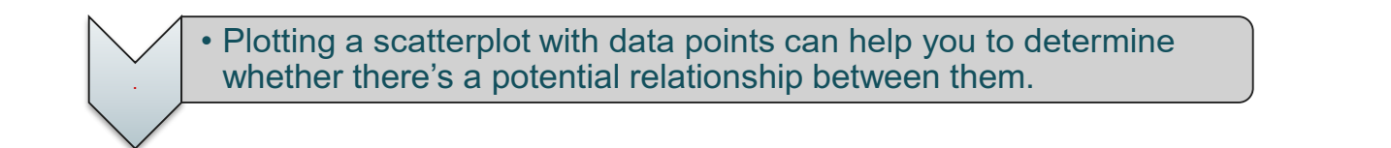

Slide 17
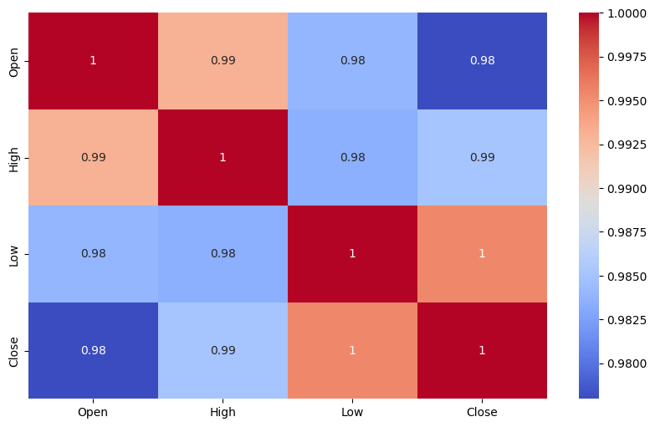
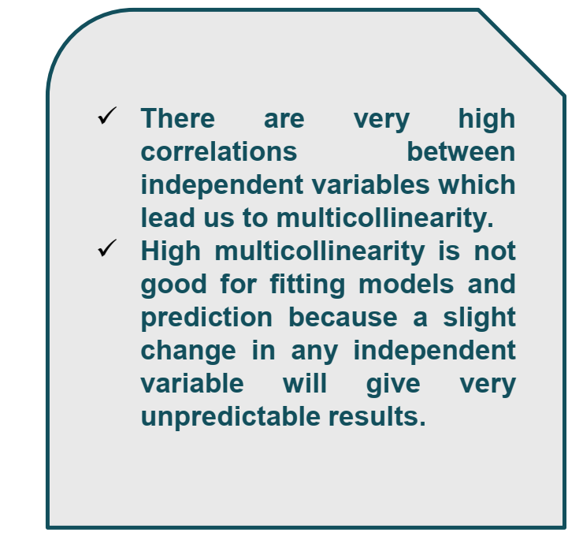

Slide 18

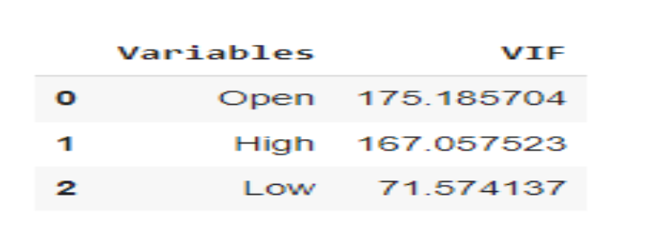
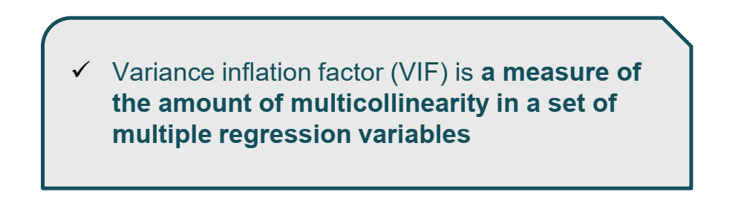
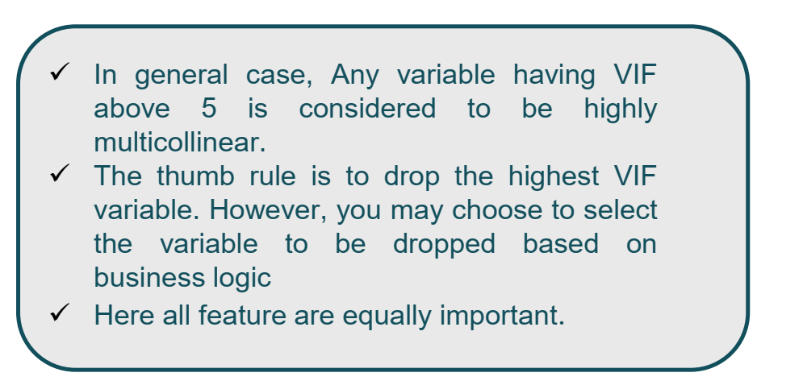

Slide 19
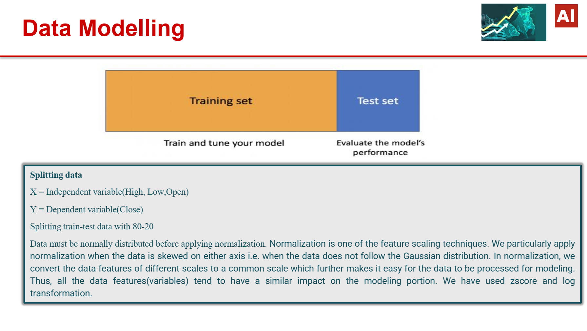

Slide 20
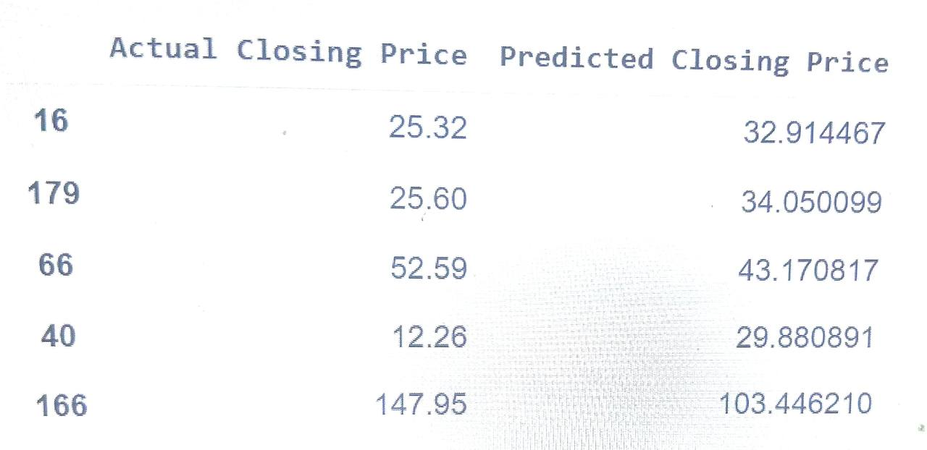
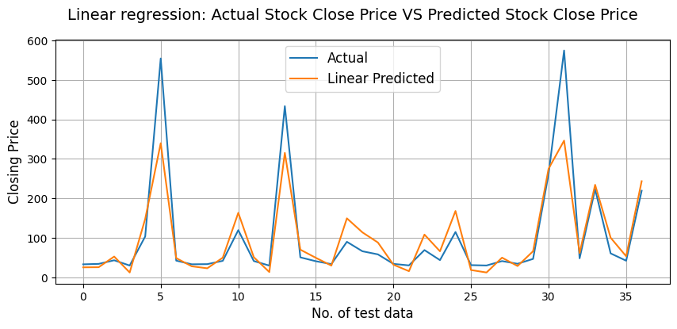
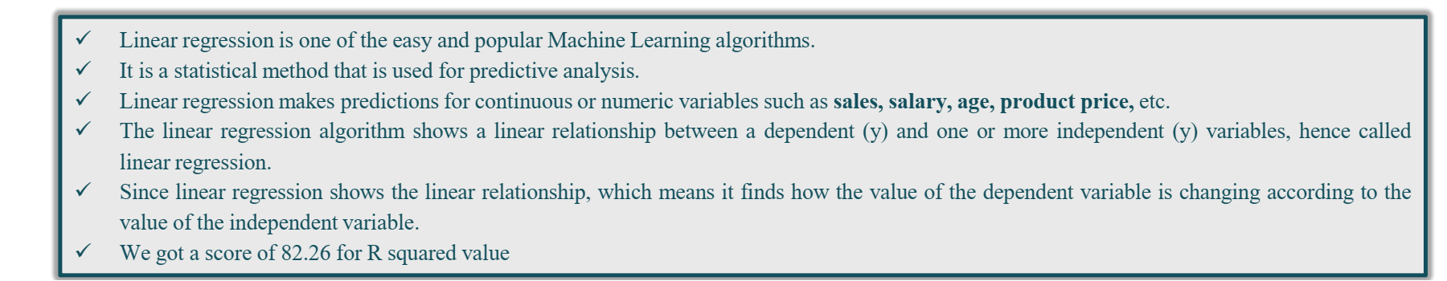

Slide 21
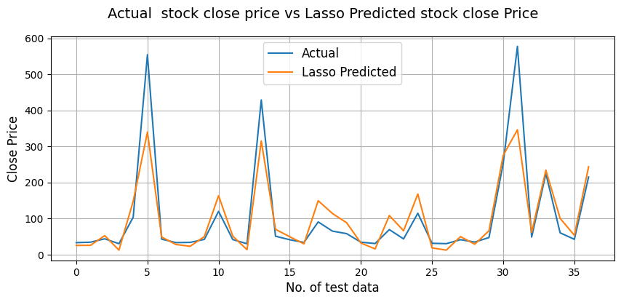
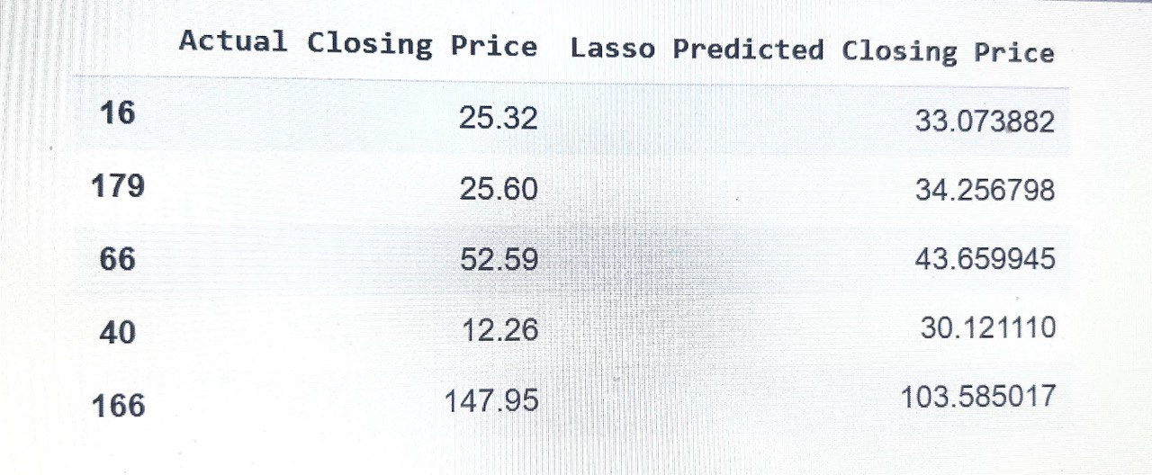
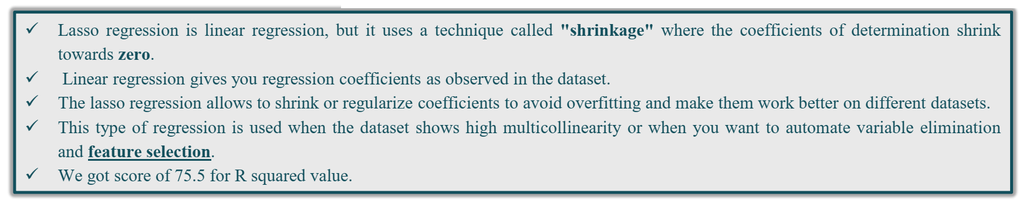
Lasso Regression
We Got Score of 82.02 For R-Squared Value

Slide 22

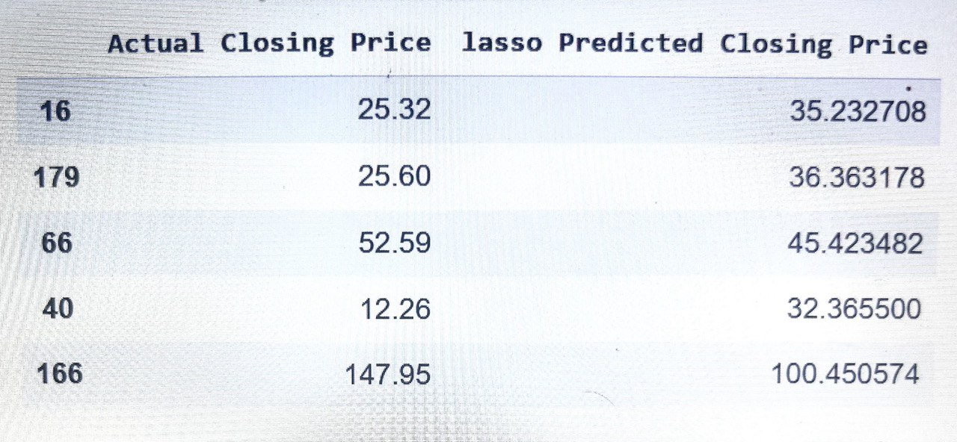
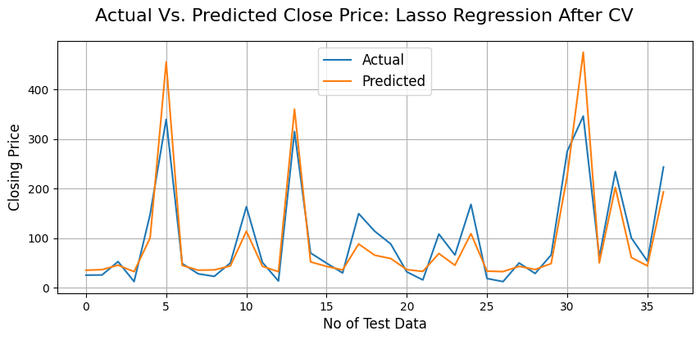

Slide 23
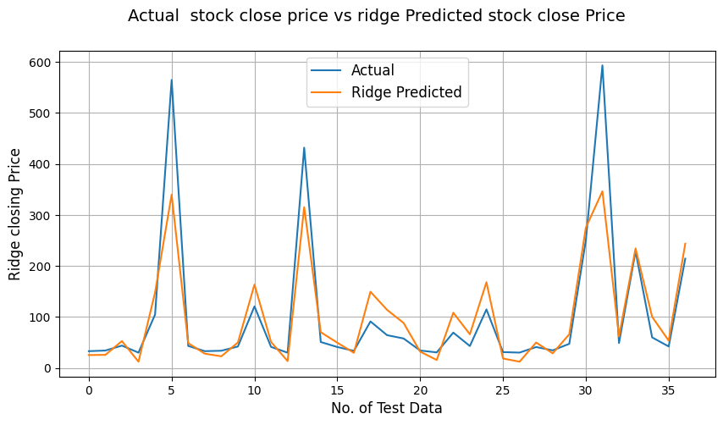
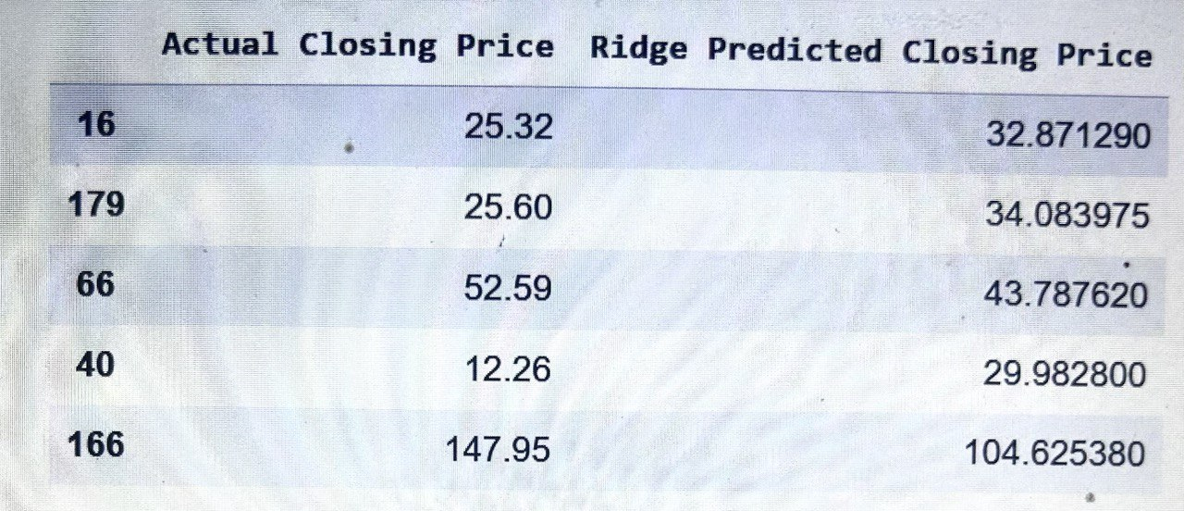
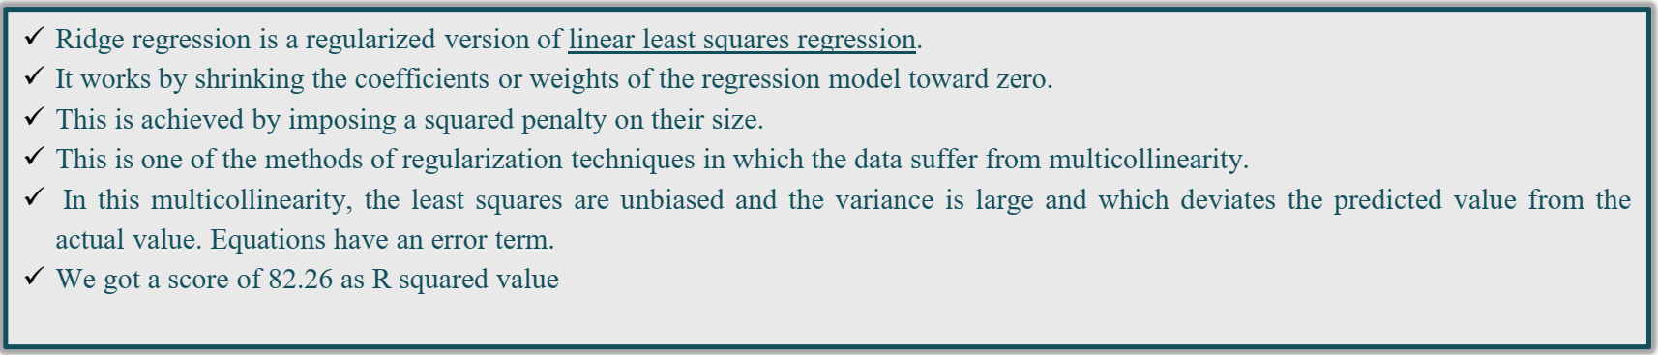
We Got a Score of 81.97 as R-Squared Value

Slide 24

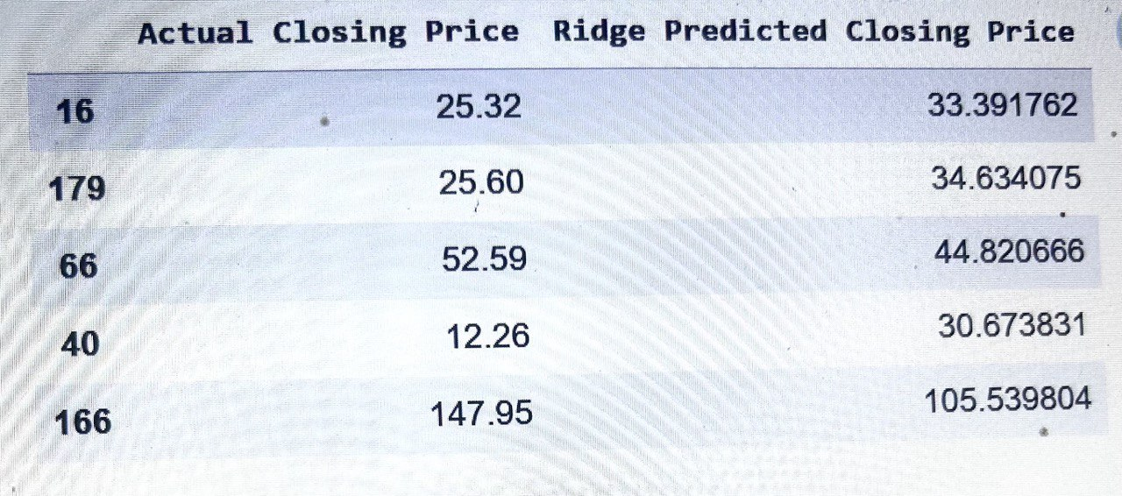

Slide 25

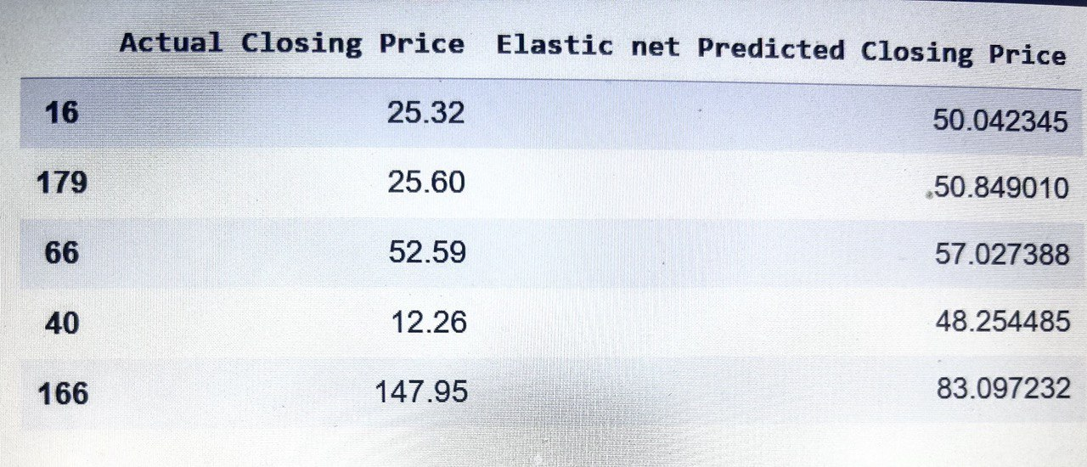
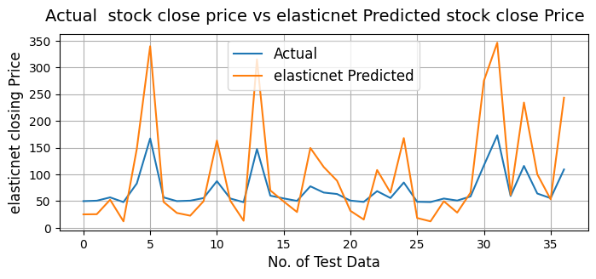
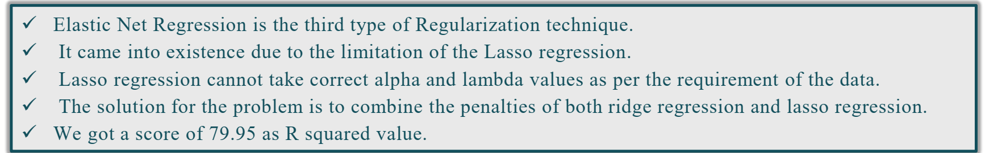
We Got a Score of 53.09 as R-Squared Value

Slide 26



Slide 27



Decision Tree
A decision tree is a flowchart-like structure in which each internal node represents a test on a feature (e.g. whether a coin flip comes up heads or tails) , each leaf node represents a class label (decision taken after computing all features) and branches represent conjunctions of features that lead to those class
We Got a Score of 98.87 as R-Squared value

Slide 28


Random Forest
Random forest algorithm builds a forest in the form of an ensemble of decision trees which adds more randomness while growing the trees.
We Got a Score of 99.06 as R-Squared value

Slide 29


Slide 30


Slide 31

6. Decision Tree Regressor has given the best result with lowest MAE,MSE,RMSE AND MAPE Scores.
7. Ridge regression shrunk the parameters to reduce complexity and multicollinearity but ended up affecting the evaluation metrics.
8. Lasso regression did feature selection and ended up giving up worse results than ridge which again reflects the fact that each feature is important (as previously discussed).
9. Random Forest end up giving the highest R squared value. The predicted values are nearly equal to the actual values. We got 99% accuracy.
10. Linear regression , Lasso regression and Ridge regression showed nearly equal accuracy.

Slide 32


simplilearn

Slide 33
Thank You

